Slide 1



Internship at Orbitax
Course : SWE 420
10 August, 2023
Iftekharul Haque Noor
Registration No: 2018831058
Department of Software Engineering, IICT, SUST

Slide 2
About Orbitax
Provides global tax software solutions.
Head office located at San Francisco, California, USA.
Development and Business Team located in Dhaka, Bangladesh.
One of the top solutions in the market.
Known for its remarkable work environment and employee facilities.

Slide 3
Internship Activities
Training : Studying relevant technologies and tools.
Individual Project: Developing a web application with CRUD functionalities using REST API.
Production:
Created a private domain for the orbitax ecosystem.
Added different features as per requirement.
Fixed different bugs that were issued.

Slide 4
Training
Tools:
Bitbucket
Sourcetree
Postman
Visual Studio
VS Code
Chrome Dev Tools
Jira
Swagger
Docker
bitax
Technologies:
C#
.Net Core
JavaScript
Angular
REST API
MongoDB
JWT
Git
ElasticSearchDB

Slide 5
Individual Project:
Library Management Web Application

Slide 6
Project Features
User registration and login
Librarian can Add and Remove books.
Book availability status changes when borrowed.
Books are viewed using pagination.
JWT authentication, authorization and validation.
Implementation of REST API and HTTP methods.
Docker image creation.

Slide 7
Tools and Technologies
FrontEnd:
Angular
Tailwind CSS
Axios
Redux
Git
Backend:
.Net
MongoDB
Swagger
NUnit
Docker

Slide 8
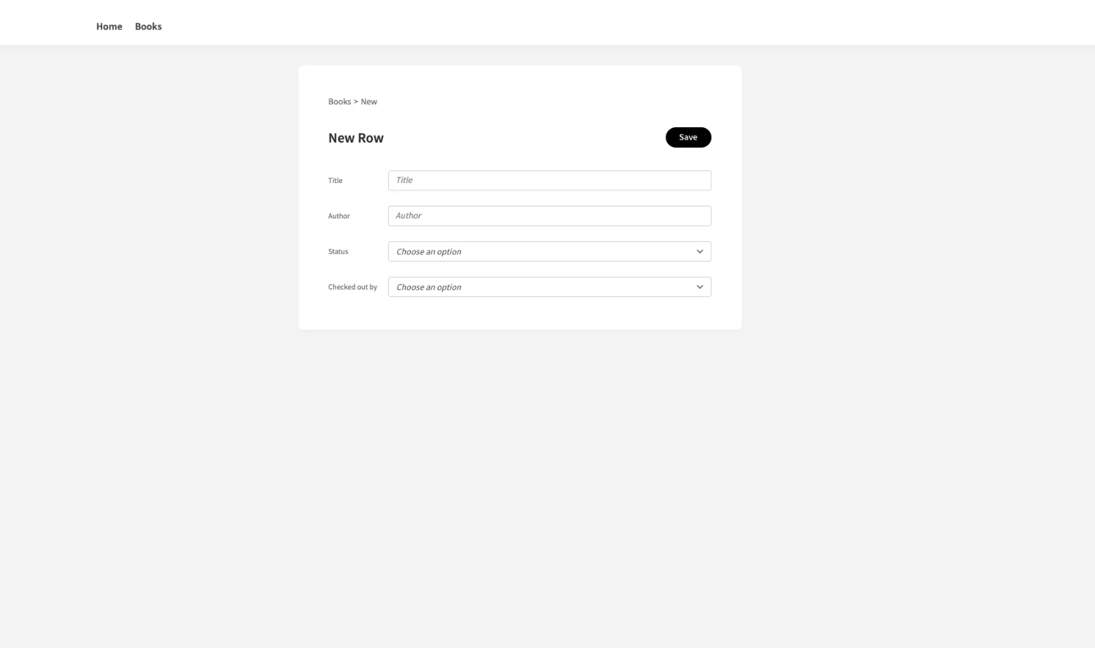
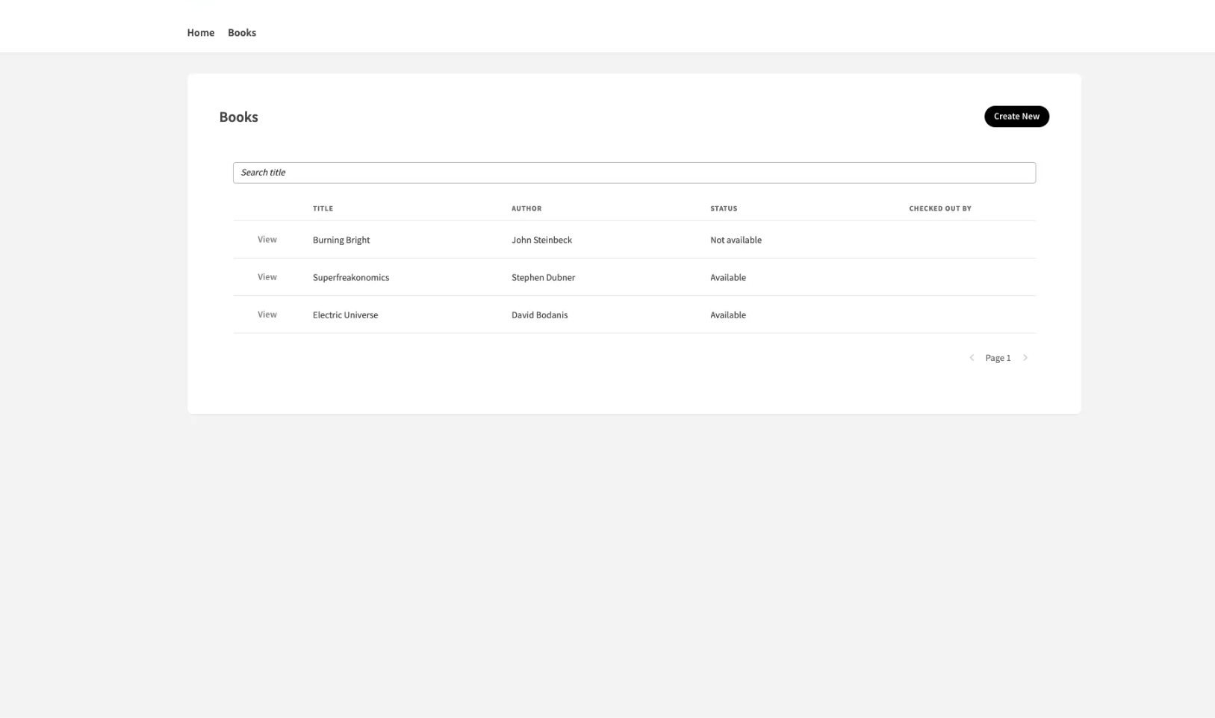
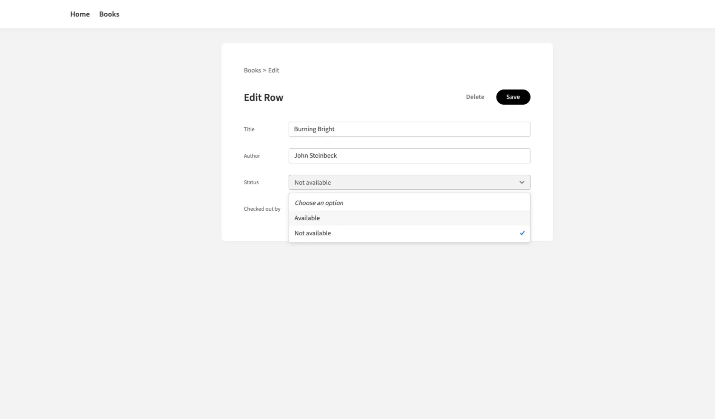
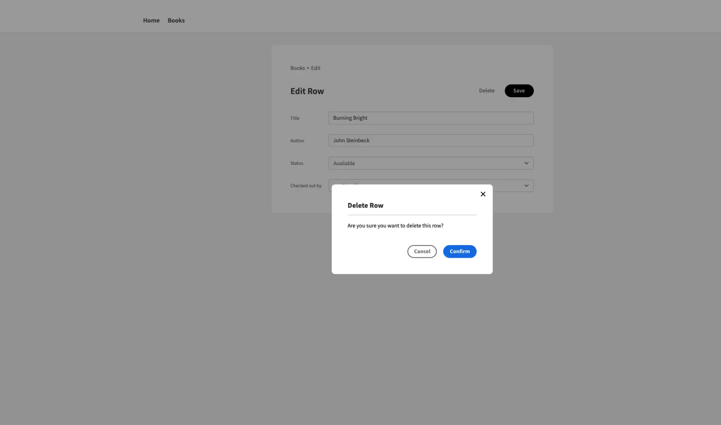
Project Screenshots
1.
2.
3.
4.

Slide 9
Production

Slide 10
Orbitax Logger
Single-handedly created a private domain for Orbitax.
Streamlined the Orbitax user support system.
Helps to identify issues quickly.

Slide 11
Orbitax Logger Features
Authentication using Orbitax’s existing system.
Show logs from all API of the ecosystem in a paginated format.
Validate and sort legible and usable logs.
Logs can be narrowed down to individual user and company.
All data from all API simultaneously can automatically converted and exported in xlsx format.
Data is sorted into separate worksheets for separate APIs.
Built on Orbitax’s convention.

Slide 12
Tools and Technologies
FrontEnd:
Angular
Tailwind CSS
Axios
Redux
JWT
Git
Backend:
.Net
MongoDB
SpreadSheetGear
ElasticSearchDB
Swagger
NUnit
JWT
Docker
Tools:
Bitbucket
Postman
Docker
Jira
Sourcetree

Slide 13
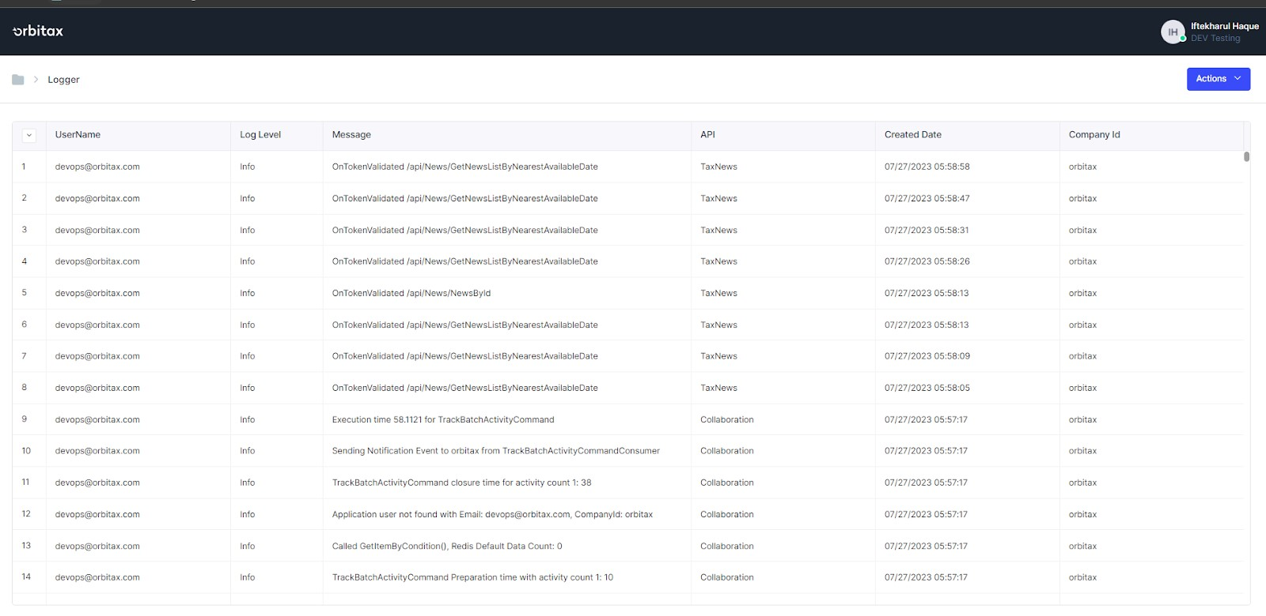
Orbitax Logger Screenshots
View and validate logs

Slide 14
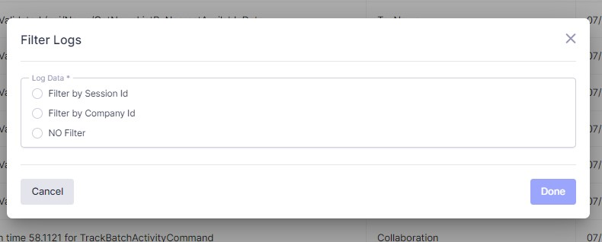
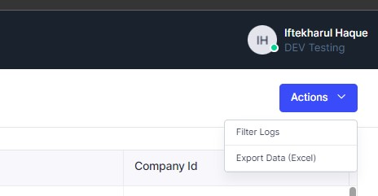
Orbitax Logger Screenshots
Filtering
Authentication and other functions

Slide 15
Feature Implementation
Filestore and SpreadSheet API
Improved on Questionnaire field visibility.
Adding questionnaire conditional formatting.
Questionnaire conditional formatting export to xlsx format.
Extension the functionality of questionnaire fields.
Importing entity data to ITP from questionnaire.

Slide 16
Feature Implementation
Flow API
Added EAT navigation nodes.
Adding relative url to EAT landing pages.
Other APIs
Improved on existing features on different parts of the orbitax ecosystem.
Implementing filters
Dialog box workflows

Slide 17
Bug fixes
Fixed numerous bugs that arised.
APIs:
Filestore API
Spreadsheet API
Flow API
Entitychart API

Slide 18
Thank You

